Slide 1


R Programming Basics, Part I
- Poke the Box! -
Notes:
You’ll notice I named this session “Poke the Box”, which I think is a productive mentality when approaching a new programming language.
The basic mentality: TRY STUFF – see what happens. What can we learn?
We’ll start by looking at some (maybe painfully) basic input & output, and talk about what insights we can gain.

Slide 2
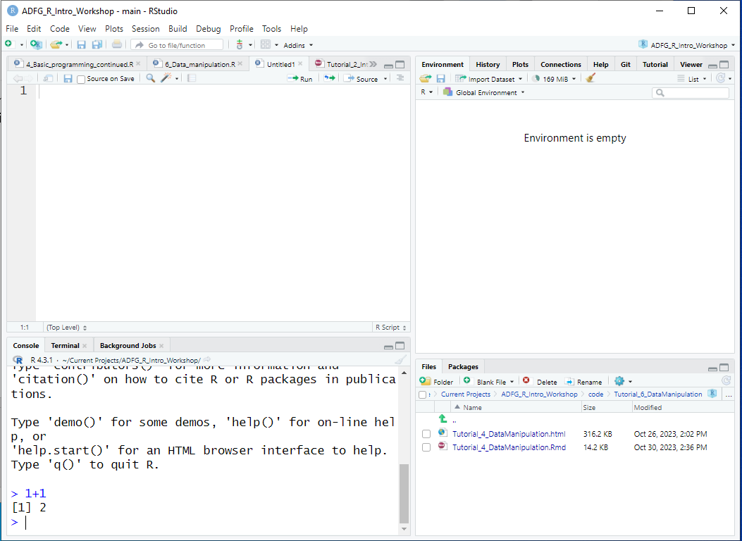
Poke the box R console!
There was a “>” with a flashing cursor after it
I typed this and hit Enter
> 1+1
[1] 2
R printed this!
You can ignore the [1] thing for now
Notes:
Can’t get more basic than this
Here’s an RStudio window, and zooming in on the Console…

Slide 3
Poke the box R console!
Insights…
R does math!
For now, you can think of it as a fancy calculator
1+1
[1] 2
Notes:
Already, there are some insights!
--
R does math … which is reassuring
--
You can even think of R like a calculator: Each line can be its own operation, which takes the pressure off! You don’t have to write a complete “program” to see results

Slide 4
Poke the box R console!
Insights…
R does math!
R ignores whitespace between things
You can space things out for readability
1+1
[1] 2
1 + 1
[1] 2
Notes:
What do you see about the DIFFERENCES in how these two lines evaluated?
What does that tell us?

Slide 5
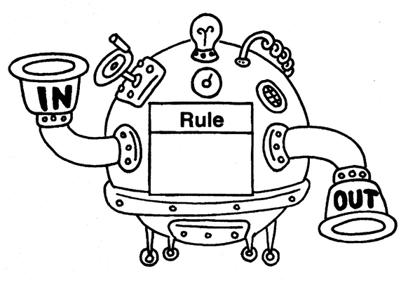
Poke the box R console!
Insights…
R does math!
R ignores whitespace between things
R uses functions
Things that go inside the parentheses (function inputs) are referred to as “arguments” of the function
1+1
[1] 2
1 + 1
[1] 2
sqrt(49)
[1] 7
Notes:
How about this line? What happened? (it took the square root of 49!)
--
Maybe more generally, R uses FUNCTIONS.
--
Here’s a little bit of R terminology: the inputs (or … stuff that go inside the parentheses) are referred to as ARGUMENTS

Slide 6
Poke the box R console!
Insights…
R does math!
R ignores whitespace between things
R uses functions
R is case-sensitive
Errors happen!!!
YOUR COMPUTER WILL NOT EXPLODE
“Errors are not problems, just puzzles” (Error messages might be clues)
1+1
[1] 2
1 + 1
[1] 2
sqrt(49)
[1] 7
Sqrt(49)
Error in Sqrt(49) : could not find function "Sqrt"
Notes:
What does this tell us? Case sensitivity.
--
But, maybe a MORE important insight: ERRORS HAPPEN! And with every error, we get a message that might give us some clues as to what went wrong
Note: the “could not find function” probably just means something is spelled wrong (or in this case, capitalized wrong)

Slide 7
Poke the box R console!
meaningOfLife <- 42
meaningOfLife
[1] 42
meaningOfLife + 1
[1] 43
What do you think will happen?
Notes:
How about these TWO lines? What happened?
--
Meaning of life, adjusted for inflation?

Slide 8
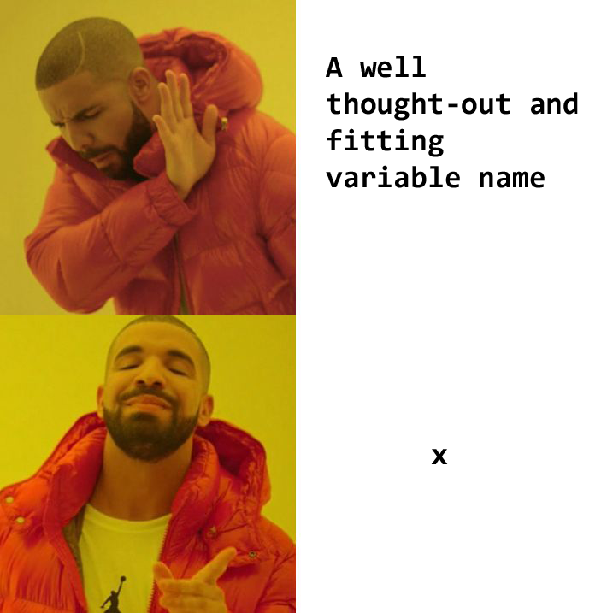
Poke the box R console!
Insights…
You can store variables using “<-”
Sometimes people say “gets” as verbal shorthand
Terminology: this is sometimes referred to as an assignment statement
You can make names descriptive
meaningOfLife <- 42
meaningOfLife
[1] 42
meaningOfLife + 1
[1] 43
Notes:
--
… you can store variables using this angle bracket hyphen thingy that looks like a leftward arrow…

Slide 9

What if I have more than one number?
First, a few new tools:
The c( ) function can be used to construct a vector, that is, an ordered set
Don’t worry, functions that read data directly from .csv, .txt, xlsx, etc. will be introduced soon!
c(1, 1, 2, 3, 5, 8)
[1] 1 1 2 3 5 8
Notes:
Ok, we stored one number … but you’ve probably got a lot more than that!
Introducing the c() function (c for concatenate)
…and this is an important enough concept that it gets its own name. If it’s helpful, you can think of a vector as being like ONE COLUMN of a spreadsheet.
And by the way: you won’t have to type stuff by hand like this very often: Most of the time you’ll be reading data from an external file.
BUT it’s worth looking at some simplified examples first, so you’ll have an intuition for how things will behave once it’s read INTO R.

Slide 10
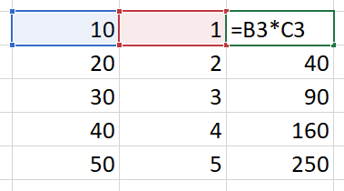
Introducing vector operations…
The most basic structure in R is a vector
Many (most) operations in R can be evaluated vector-wise
What does this mean?
a <- c(10, 20, 30, 40, 50)
b <- c(1, 2, 3, 4, 5)
a * b
[1] 10 40 90 160 250
Mental model for Excel users:
Notes:
… so here’s a silly example
… we get a vector OUT, and check out how this works:
If it’s useful, you can think of this like dragging a formula down in Excel – and just like Excel, the RELATIVE POSITION gets preserved

Slide 11
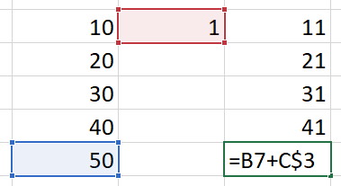
Introducing vector operations…
The most basic structure in R is a vector
Many (most) operations in R can be evaluated vector-wise
What does this mean?
What happens when you mix vectors and single numbers?
a <- c(10, 20, 30, 40, 50)
b <- c(1, 2, 3, 4, 5)
a * b
[1] 10 40 90 160 250
a + 1
[1] 11 21 31 41 51
Mental model for Excel users:
Notes:
I can hear you thinking, what happens when you mix vectors and single numbers?
… you get a vector out, but it adds one to ALL elements
So maybe this is how it works in Excel land?

Slide 12
Notes:
DEMONSTRATIVE CODING BREAK

Slide 13
QUIZ: How would the following evaluate?
xx <- c(1, 2, 3)
yy <- c(10, 20, 30)
xx + yy
[1] 11 22 33
[1] 66
Something else
An error or warning
Notes:
So let’s try this.
What do you think will happen?

Slide 14
QUIZ: How would the following evaluate?
xx <- c(1, 2, 3)
yy <- c(10, 20, 30)
xx + yy
[1] 11 22 33
[1] 66
Something else
An error or warning
Length 3
Length 3
Result will be length 3

Slide 15
QUIZ: How would the following evaluate?
xx <- c(1, 2, 3)
yy <- c(10, 20, 30)
zz <- 1000
xx + yy + zz
[1] 1011 22 33
[1] 1011 1022 1033
Something else
An error or warning
Notes:
How about this one?
Same two vectors from before, but now we add a single number.

Slide 16
QUIZ: How would the following evaluate?
xx <- c(1, 2, 3)
yy <- c(10, 20, 30)
zz <- 1000
xx + yy + zz
[1] 1011 22 33
[1] 1011 1022 1033
Something else
An error or warning
Length 3
Length 3
Length 1
Result will be length 3

Slide 17
What if I have more than one number?
First, a few new tools:
The c( ) function can be used to construct a vector, that is, an ordered set
The : operator can be used to construct a sequence of integers
c(1, 1, 2, 3, 5, 8)
[1] 1 1 2 3 5 8
2014:2023
[1] 2014 2015 2016 2017
[5] 2018 2019 2020 2021
[9] 2022 2023
Insight…
That weird [1] thing we keep seeing? It’s just R labeling where each line of output starts!
Notes:
Here’s a couple more ways of making a vector from scratch…
Another tool is the colon operator, which makes an integer sequence
also sounds like a laxative XD
Oh, and remember that [1] thing in square brackets we kept seeing? Now what do you think it means?
It’s just saying where each line of printed output starts!

Slide 18
What if I have more than one number?
First, a few new tools:
The c( ) function can be used to construct a vector, that is, an ordered set
The : operator can be used to construct a sequence of integers
The seq( ) function can be used to construct a custom sequence
c(1, 1, 2, 3, 5, 8)
[1] 1 1 2 3 5 8
2014:2023
[1] 2014 2015 2016 2017
[5] 2018 2019 2020 2021
[9] 2022 2023
seq(from=0, to=1, by=0.2)
[1] 0.0 0.2 0.4 0.6 0.8 1.0
seq(from=0, to=1, length.out=6)
[1] 0.0 0.2 0.4 0.6 0.8 1.0
Insights…
There are often multiple ways to do the same thing in R
Functions can have multiple possible arguments
Notes:
The seq() function…
Now before you try memorizing all the different arguments you see here, I actually want to call attention to two things:
- there’s often multiple ways of doing the same thing
- functions can have multiple possible arguments

Slide 19
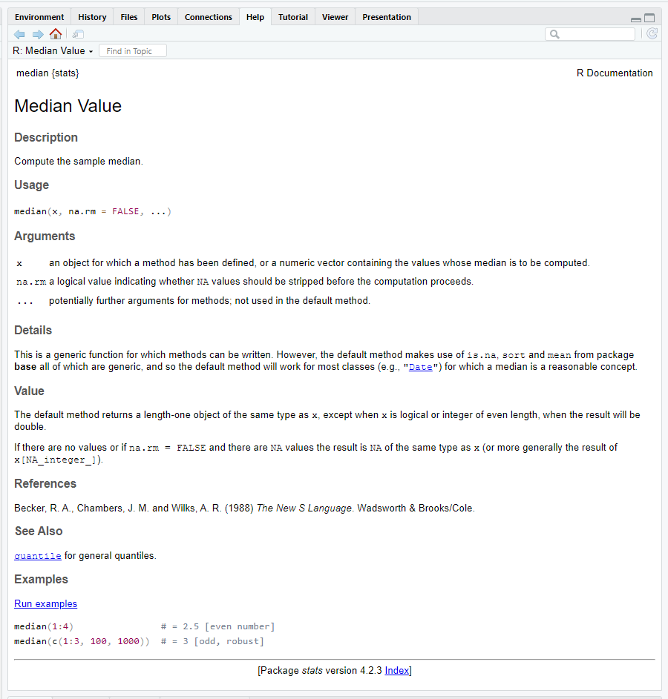
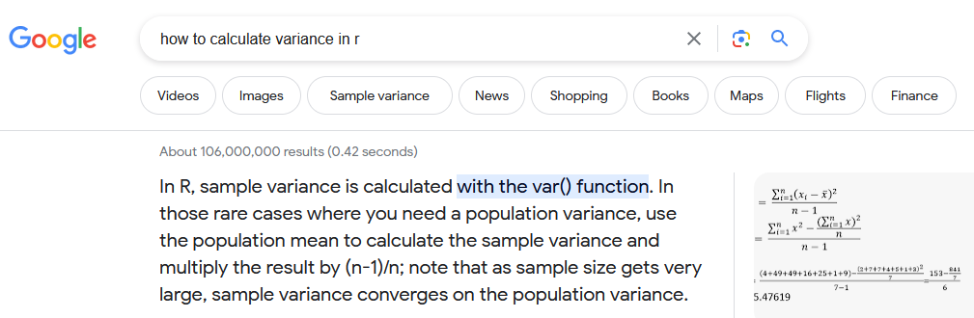
Help!
?median
help("median")
Notes:
And thankfully, you don’t have to memorize all the things, because there is HELP!

Slide 20
Some operators & functions…
The usual cast of characters: +, -, *, /, ^
1+2*3-4^5/(6-7)
[1] 1031
1+(2*3)-((4^5)/(6-7))
[1] 1031
Insights…
You can use parentheses in mathematical operations, too
R is pretty smart about order of operations (but I’m still nervous to trust it!)
Notes:
Ok, so let’s build the vocabulary a little.
We have all the math things: addition, subtraction, multiplication, division, and exponents
We can also use parentheses as needed when we’re doing math

Slide 21
Some operators & functions…
The usual cast of characters: +, -, *, /, ^
sqrt(), log(), exp(), abs()
1+2*3-4^5/(6-7)
[1] 1031
1+(2*3)-((4^5)/(6-7))
[1] 1031
sqrt(c(0, 1, 4, 9, 16, 25, 36))
[1] 0 1 2 3 4 5 6
Insight…
Mathematical functions can generally be evaluated vector-wise
Notes:
A few more math things: square root, log, exponential, absolute value
Notice that when we put a vector in, we get a vector out.
You’ll also notice we had to tell R that it was a vector! How did we do that?

Slide 22
Some operators & functions…
The usual cast of characters: +, -, *, /, ^
sqrt(), log(), exp(), abs()
sum(), prod()
mean(), median(), quantile(), sd(), var()
1+2*3-4^5/(6-7)
[1] 1031
1+(2*3)-((4^5)/(6-7))
[1] 1031
sqrt(c(0, 1, 4, 9, 16, 25, 36))
[1] 0 1 2 3 4 5 6
median(c(0, 1, 4, 9, 16, 25, 36))
[1] 9
Insight…
Some functions need a vector input!
Notes:
A few more math things that only make sense with a vector input
Sum, product, mean, median, quantile, standard deviation, and variance
There’s more, this is just a few examples

Slide 23
Let’s talk about NA
a <- c(1, 2, 3, 4, NA)
b <- c(2, 4, 6, 8, 10)
a + b
[1] 3 6 9 12 NA
mean(a)
[1] NA
mean(a, na.rm = TRUE)
[1] 2.5
An NA is a placeholder for an unknown value
Blank cells in spreadsheets are typically imported as NA
R will generally return NA or Error when NA is used in calculations
Which is good!
There are ways around this, if appropriate
Notes:
An important R thing we need to talk about is NA, which is R’s way of handling blanks.
--
What happens when we try to take a mean of a vector that contains a missing value? Well, we don’t KNOW what the mean is!

Slide 24
Notes:
DEMONSTRATIVE CODING BREAK

Slide 25
Classes of vectors: R can store different kinds of information
Less complex
 | Possible values | can be used in mathematical expressions
logical | FALSE or TRUE (or NA) | yes
numeric | all numbers (or NA / NaN / Inf) | yes
character | most combinations of letters, numbers, and special characters (or <NA>) | no
Can be changed into a different class without losing information
More complex
Notes:
So far we’ve just seen numbers, but R can also store other things
Logical is simpler, it can only be TRUE or FALSE
With Character, you can store text
And things can be changed into a MORE COMPLEX class without losing information. …which will make sense in a moment.

Slide 26
Classes of vectors
myName <- "Inigo Montoya"
1 + "Bob"
Error in 1 + "Bob": non-numeric argument to binary operator
"2" + 4
Error in "2" + 4: non-numeric argument to binary operator
heres_a_logical_vector <- c(TRUE,
FALSE, TRUE, FALSE, TRUE)
heres_a_logical_vector
[1] TRUE FALSE TRUE FALSE TRUE
Title looks scary, but
It’s actually pretty obvious what can & can’t happen
Insights…
Quotes in an assignment statement tell R to interpret something as character
Note: " " and ' ' can both be used as long as you’re consistent on both sides
R knows what TRUE and FALSE mean without quotes
Notes:
But first … it’s generally pretty intuitive what can and can’t happen…
Notice that wrapping “2” in quotes tells R to treat it as Character

Slide 27
So what did I mean about changing classes?
Less complex
logical
numeric
logical
numeric
character
c(TRUE, FALSE, TRUE, FALSE, 5)
[1] 1 0 1 0 5
More complex
The result becomes numeric
Notes:
…lets look at what happens here

Slide 28
So what did I mean about changing classes?
Less complex
logical
numeric
logical
numeric
character
c(TRUE, FALSE, TRUE, FALSE, 5)
[1] 1 0 1 0 5
More complex
The result becomes numeric
Insights
All elements of a vector will be the same class!
Hey look, you can use whole vectors as arguments in c( )
numeric
character
c(seq(2, 8, by=2), "Who do we appreciate")
[1] "2" "4" "6" "8" "Who do we appreciate"
The result becomes character
Notes:
Maybe more importantly….
…and I put this one in bold because this is DIFFERENT FROM EXCEL!

Slide 29
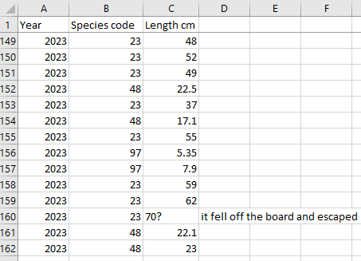
Why do we care???
Take-home messages:
Different classes (types of data) exist!
R can do different things with different classes
R may do things you didn’t intend
Will become numeric
Will become character
Notes:
So to bring it all home, just remember:
--
Side note: this is one of THE most common data errors!
Personal favorite: number with a trailing space (someone pranking the biometrician??)

Slide 30
Btw: yes, we can change classes manually
smellsLikeSchoolSpirit <- c(seq(2, 8, by=2), "Who do we appreciate")
smellsLikeSchoolSpirit
[1] "2" "4" "6" "8" "Who do we appreciate"
as.numeric(smellsLikeSchoolSpirit)
[1] 2 4 6 8 NA
Warning message:
NAs introduced by coercion
Notes:
And I can feel you asking: YES, we can change classes manually. Mostly.
…so here we see this Character vector we made a couple slides ago
And when we turn it back to numeric, it doesn’t know what to do with the last element

Slide 31
One last vector class: factor
Like character, but with a guest list!
rating_char <- c("Low","Medium","High","Low","Medium")
rating_factor <- as.factor(rating_char)
rating_char
[1] "Low" "Medium" "High" "Low" "Medium"
rating_factor
[1] Low Medium High Low Medium
Levels: High Low Medium
as.numeric(rating_factor)
[1] 2 3 1 2 3
Insights
R will probably try to alphabetize your factor levels (High will come before Low and Medium)
Not super important, just an oddity to be aware of!
Notes:
One last vector class that can be useful if you’re working with DISTINCT CATEGORIES is Factor
So we created a vector two ways: look at the difference in how R behaves
- the Factor version carries another piece of information: what categories are allowed
And this is a little odd: R will actually let you convert factor to numeric

Slide 32
When to use character?
When to use factor?
There are no specific categories of interest
Fields are open-ended
Examples…
Comments
Personnel?
Weather?
There are distinct categories
Probably related to a research question!
You’d like to do formal testing/plotting using these categories
Examples…
Species (code)
Sex
Age?
Year??
Might be numeric, depending on context!
In practice:
R will import non-numeric columns as character by default (as of 2020), rather than factor
That’s a good thing, it’s easier to make changes to character variables than factor!
R will generally treat character as factor when it needs to (ANOVA, boxplots, chi-squared tests, …)
So the distinction doesn’t matter as much as it used to
But, data summaries can be easier with factor, so it’s often worth converting character to factor
…after editing values, if that’s needed
Notes:
This might feel like splitting hairs, but since we’re talking about the differences, we should probably talk about when to use which.
But IN PRACTICE, it actually matters a little less than it might seem

Slide 33
An important special character: #
Everything to the right of # is not evaluated
2 + 2 # two by two, hands of blue
[1] 4
Notes:
One special character that you should make friends with is this hashtag guy…
And the way this works is that everything to the right of # is not evaluated

Slide 34

An important special character: #
Everything to the right of # is not evaluated
This means you can (and should) leave notes
This is called commenting your code
One day, someone will need to understand your code
IT WILL BE YOU ☺
N_hat <- (n1 + 1)*(n2 + 1)/(m2 + 1) – 1 # Chapman Estimator of abundance

Slide 35
“There are only two hard thing in computer science: Cache invalidation and naming things.” – Phil Karlton
On the topic of readability:
Names in R…
Can use letters, numbers, “_”, and “.”
Must begin with a letter (catch_2023, not 2023_catch)
Try to make names memorable and recognizable to others
Avoid using function names (e.g. mean, var, etc.)
But R is usually smart enough to handle this
Case conventions you may see:
this_is_snake_case
thisIsCamelCase
kebab-case-is-not-allowed-in-R
dot.case.is.not.recommended …for reasons we won’t get into
Notes:
Oh, and while we’re talking about readability, there are a few rules

Slide 36
Notes:
DEMONSTRATIVE CODING BREAK

Slide 37
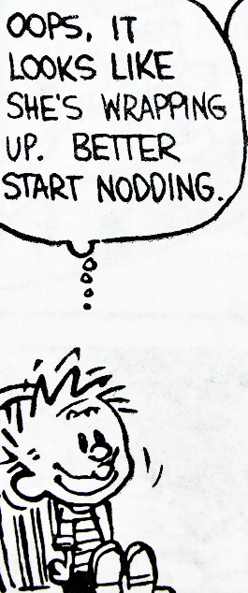
Concepts to take away from this session:
R does math!
1+2*3-4^5/(6-7)
[1] 1031
1+(2*3)-((4^5)/(6-7))
[1] 1031
Notes:
Alright! Let’s revisit the main points we saw.

Slide 38
Concepts to take away from this session:
R does math!
R uses functions with multiple possible arguments (inputs)
sqrt(49)
[1] 7
median(c(1, 1, 2, 3, 5, NA), na.rm=TRUE)
[1] 2

Slide 39
Concepts to take away from this session:
R does math!
R uses functions with multiple possible arguments (inputs)
You can store results in variables that you create
Note: these go away when you close R, but that’s a good thing
N_hat <- (n1 + 1)*(n2 + 1)/(m2 + 1) – 1
myNameIs <- c("Inigo Montoya", "Slim Shady", "Ozymandias")

Slide 40
Concepts to take away from this session:
R does math!
R uses functions with multiple possible arguments (inputs)
You can store results in variables that you create
Note: these go away when you close R, but that’s a good thing
R uses vectors (ordered sets) and does most operations vector-wise
vector
vector
single number (actually a vector of length 1)
c(1, 2, 3) * c(10, 20, 30) + 5
[1] 15 45 95
vector

Slide 41
Concepts to take away from this session:
R does math!
R uses functions with multiple possible arguments (inputs)
You can store results in variables that you create
Note: these go away when you close R, but that’s a good thing
R uses vectors (ordered sets) and does most operations vector-wise
There are different classes of vectors (logical, numeric, character, factor) for storing different types of information
Don’t worry about memorizing this, it’s just for reference!
Class | Possible values | Can it math?
logical | FALSE or TRUE (or NA) | yes
numeric | all numbers (or NA / NaN / Inf) | yes
factor | most combinations of letters, numbers, and special characters from a defined set (or <NA>) | no
character | most combinations of letters, numbers, and special characters (or <NA>) | no
Can be changed into a different class without losing information
FALSE = 0, TRUE = 1

Slide 42
Also…
Help exists!
NA is a placeholder for an unknown quantity
# lets you add helpful notes to others or yourself
Errors and Warnings happen all the time, and may offer clues
“Error” means line of code didn’t evaluate
“Warning” means it did evaluate

Slide 43



One last thing!
Escaping incomplete lines
R ignores whitespace between things, which includes <return>
The “+” means R is waiting for you to “add” the rest of what you’re telling it
Solution:
Click in the console
Hit the <esc> key
Try again

Slide 44
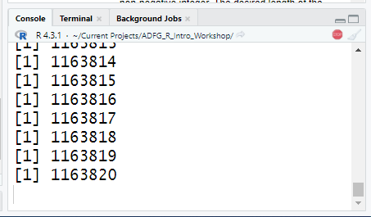
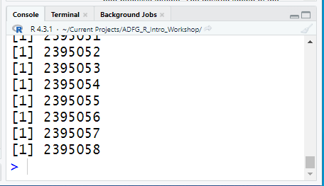
One last thing!
Escaping long-running code
Maybe R is working hard on something you didn’t intend!
Look for the red stop sign
Solution:
Click the red stop sign!
Console + <esc> might work too

